Slide 1
Initiating an Experiment
Module 2 of 6
Experimentation in the Government of Canada

Slide 2
Module 1 Recap
Module 1 Summary
Experimentation is about finding what does and does not work in order to inform decisions.
Experimentation can be considered a de-risking strategy – it can be implemented at a small scale to determine impact early on before (costly) scaling.
Experimentation is part of a learning process where robust and relevant evidence is gathered in order to inform course corrections, if needed.
Experimentation is advantageous over other approaches because it deals more effectively with questions of a causal nature (does X have an impact on Y).

Slide 3
Course Overview
Course Outline
Designing an Experiment What methodological options are available and appropriate?
Implementing an experiment What are the practical requirements, especially in a public administration setting, to implementing an experiment?
MODULE 3
MODULE 4
Initiating an Experiment What do you need to consider before starting an experimental project?
Analyzing an experiment What analytical options and resources are appropriate to analyze experimental data?
MODULE 2
MODULE 5
Introduction to Experimentation What is an experiment and why are they important?
Informing decisions with experiments How can experimental evidence be used to inform decisions?
MODULE 1
MODULE 6

Slide 4
Module 2 Overview
Learning Objectives
By the end of this module, learners should be able to:
Identify the steps needed before starting an experiment
Devise a problem statement for an experiment project
Develop a research question
Share the project with stakeholders and get buy-in
Apply experimentation knowledge to initiate an experiment (examples)

Slide 5
Module 2 Overview
Prerequisites / Assumptions
An interest in experimentation, willingness to experiment, and an appetite for informed consummation of evidence
Admission that we don’t know all answers but we can put our ideas to test
Experimentation necessitates a mature attitude from leaders and decision-makers, one that is willing to experiment and learn positively from “good failure” rather than pretending we have all the answers
A team of knowledgeable partners with expertise in experimentations methodologies with a transparent and “open-by-default” approach

Slide 6
Experimenting in the Government of Canada Module 2: Initiating an Experiment
02
Initiating an Experiment
What do you need to consider before starting an experimental project
Themes explored in Module 2
Deciding to experiment
Running an experiment
Defining the problem
Developing a research question
Getting endorsements
Examples of Experimentation

Slide 7
Module 2 Introduction
Before embarking on the experimentation journey, you should ask the question ‘Do you have to run an experiment?’ As discussed in Module 1, experiments provide answers to very specific questions – they will likely not answer questions that are not causal in nature.
Designing an implementing an experiment can take time, motivation, skills, and often financial resources. It is not always immediately clear what combination of resources you will need for your experiment, given that they’re not the first thing considered when trying to answer a question.
Embarking on the experimentation journey will require significant cross-functional collaboration, stakeholder buy-in, and lots of preparatory work – but it all starts with having clear and thoughtful design for your research question, and then landing on an implementation plan before starting.
Experimentation is often described as a method, approach, a test, a tool to generate evidence. All of these are true, but first and foremost experimentation is a problem-solving process. The starting point for any experiment should be the problem you are trying to solve.
Notes:
Controlled Experiments: Lab experiments are controlled experiments, although you can perform a controlled experiment outside of a lab setting! In a controlled experiment, you compare an experimental group with a control group. Ideally, these two groups are identical except for one variable, the independent variable.
Field Experiments: A field experiment may be either a natural experiment or a controlled experiment. It takes place in a real-world setting, rather than under lab conditions. For example, an experiment involving an animal in its natural habitat would be a field experiment.
Natural Experiments: A natural experiment also is called a quasi-experiment. A natural experiment involves making a prediction or forming a hypothesis and then gathering data by observing a system. The variables are not controlled in a natural experiment.

Slide 8
Deciding to Experiment

Slide 9
Running an experiment
STEP 1 Problem Statement Identify what the issue is, what possible improvements may look like.
STEP 7 Report back and adapt Present the results and disseminate the evidence to identify key learnings, then adapt your program / operation based on what the evidence dictates.
STEP 2 Identify Intervention(s) Determine what the intervention / treatment might look like in your program / operation.
STEP 3 Determine outcome measure(s) Determine what you might want to measure and what the hypothesized effects may be.
STEP 6 Data Analysis Analyze data to test the effects of the intervention (for instance, by comparing the differences across groups using control variables)
EXPERIMENTATION
Steps for running an experiment
STEP 4 Design options Determine if randomization is possible, what the sampling unit and approach might be, how the control group might be set up as well as how many observations are needed based on power calculations.
STEP 5 Implement intervention and measure outcome & impact Roll out intervention and collect data* based on the chosen design. *Ensure access to data is digital and easy to extract/attribute.
Notes:
A famous paper demonstrating the massive effect default choices have on organ donation compliance rates.
Those countries where people are required to opt-out of organ donation report significantly higher consent than those with an opt-in policy.

Slide 10
Defining the problem
The problem you are trying to solve could be in any field (agriculture, natural resources, fiscal policy) and at any level (affecting 20 people, or all of Canada’s population). The problem could touch on policy, program, service delivery, regulatory affairs, or internal services.
The right scale and scope of the experiment will be dictated by what decision-makers need to know, coupled with the various practical constraints that inevitably will come through the design process.
Figuring out the problem will take time, and needs to be done in consultation with as many parties impacted by the experiment’s results (directly or indirectly). Before starting to define the problem, take the time to discuss with colleagues, management, and others on what it is (exactly) that you wish to fix.
Notes:
A problem well-stated is half-solved!
The starting point for your experiment should not be the methodology, nor a predetermined answer; it should be the problem you are trying to resolve.
E.g. RCT in Malawi where treatment groups received financial incentives to pick up their HIV results. Even a tiny incentive of $0.30-$0.50 doubled the percentage of people coming to collect their results compared to the control, before tapering off quickly as the incentive increased.
This paper looked at improving child immunization rates in India with small incentives. 134 villages in India were randomised into 3 groups; (A) A monthly immunisation camp, (B) A monthly immunisation camp with incentives (raw lentils & metal plates for completed immunisation) and (C) the Control (no intervention). Group B outperformed A in achieving full immunization by a factor of two despite the only notable difference between the addition of a small reward

Slide 11
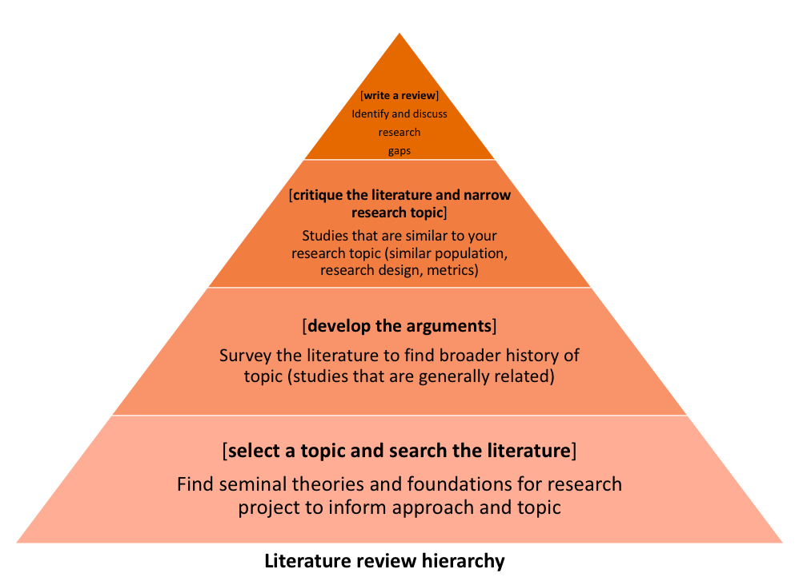
Literature review as an initial step
The purpose of the literature review is to provide a critical written account of the current state of research on a selected topic

Slide 12
Components of a literature review
Components of the literature review
The literature review should include the following:
Objective of the literature review
Overview of the subject under consideration.
Clear categorization of sources selected into those in support of your particular position, those opposed, and those offering completely different arguments.
Discussion of both the distinctiveness of each source and its similarities with the others.
Steps in the literature review process
Preparation of a literature review may be divided into four steps:
Define your subject and the scope of the review.
Search the library catalogue, subject specific databases and other search tools to find sources that are relevant to your topic.
Read and evaluate the sources and to determine their suitability to the understanding of topic at hand
Analyse, interpret and discuss the findings and conclusions of the sources you selected.

Slide 13
Example for Defining the problem
Consider this scenario: Instructors at a large university do not show up for technology training sessions. What do you think is the problem?
The time frame for the training sessions does not meet the instructors' schedules.
There is no reward for investing time in training sessions.
The notifications for the training are sent in bulk mailings to all email accounts.
Any and all options could be correct, However, these different options will define the problem as either one of time, one of rewards or one of ignorance.
A better definition of the problem:
Instructors who teach online are required to use certain technologies but have not received training in these technologies despite the fact that training is offered on various days of the week and at multiple times during the day. In this case the problem might be defined as:
Lack of motivation - No, they are required to attend this training.
Lack of reward - No, their reward is their position as an online instructor.
Lack of notification - Aha!, this might be part of the problem and requires some investigation.
Notes:
Step 1: problem statement
Step 2-3: Identify the intervention and determine the outcome
step 4: consider design options
Report back and adapt (step 7)
Step 5: implement the intervention – collect and analyze data

Slide 14
Defining the problem
Your problem statement should be clear and precise, but also scoped into a relevant policy area that is within your reach.
A problem that has too little impact to be deemed important is likely not a great fit, nor is a problem with little decision-making implications very useful to be explored. Similarly, problem statements that are too vague need to be modified so they are scoped properly.
For example, do not use:
The way government distributes passports is not effective.
Instead, try something much more narrow:
Will more new Canadians apply for a passport if the application can be done online rather than solely in-person?
It may also be worth questioning whether the problem is perhaps not causal in nature, in which case an observational study may be better.
Notes:
The starting point for your experiment should not be the methodology, nor a predetermined answer; it should be the problem you are trying to resolve.

Slide 15
Tips for Defining the problem
Step 1: Choose a topic 1. What do I find interesting about the subject? 2. What is known about the subject? 3. What is missing and what are the gaps?
Step 2: Narrow the topic 1. What do you need to know more about on the topic? 2. Are you interested in social, political, economic, gender, religious issues related to your topic? - Find a “slant” on your topic and determine the root causes (physical, social, or organizational causes) - Develop possible solutions and select a solution 3. Will the results reveal something new or unexpected? 4. What is in scope and what is out of scope? 5. Can you clearly define hypotheses (If…then…) and explicitly state research questions?
Step 3: Find Resources 1. Build on existing knowledge to address critical questions, 2. What is already done on the topic and how can our design improve or build on current knowledge. 3. Perform a systematic literature search by using the keywords you have compiled and use them to search for books in Library Catalogs, blogs, or articles in online databases 4. Consult with experts and seek feedback
Through a MECE (mutually exclusive and collectively exhaustive) proposal, we will be able to make statements that do not overlap in content and fully describe the problem at the highest level.
Step 4: Seek collaboration 1. Make sure the question is one that other people can get behind and support 2. Establish collaboration agreements and executive buy-in 3. Peer-review for clarity, scientific accuracy, and feasibility 4. Does the team have the expertise required to complete the project? If not, who else needs to be on team?
Notes:
For instance, a paper looks at framing effects in healthcare and asks whether patients preference for a therapy change by having positive contextual information? (a specific and clear problem statement) In this case, they tell a group of patients that that 90% of those who have a certain operation are alive after five years. These patients are more likely to chose the operation than when they are told that after five years, 10% of patients are dead (McNeil et al. (1982), On the elicitation of preferences for alternative therapies, New England Journal of Medicine).

Slide 16
Developing a research question
With the problem statement and intervention somewhat defined, you should be able to combine these two into a clearly articulated research statement. It also requires a scope and alignment with business goals and actions.
Landing on the right research question might seem trivial given that you have a problem statement, but it is essential to properly guiding your experiment. You will use it both during the development stage and constantly revisit it, particularly in the results stage.
You’ll want to spend a lot of time on this process, expecting a lot of back-and-forth, with multiple versions and revisions – this is all quite normal. This needs to be clearly articulated before you can move on to technical design choices.
Each of the design choices depend on these crucial first steps – so don’t rush these! You will be better off if you don’t underestimate the preparatory phases leading to the experiment being conducted.
Intervention
Problem Statement
Research Question
Notes:
A good research topic is broad enough to allow you to find plenty of material, but narrow enough to fit within the size and time constraints of your experiment
A good research question is often focused on a single topic or on several closely related ideas. If it isn’t, you won’t end up with a good design. If a question is too general or doesn’t stay on one topic, you can fix it by deciding which part of the topic you want to research.
For example, insurance companies usually struggle with honesty issues in their clients. In the case of car insurance, there is often a financial incentive to report less miles driven since reporting more would mean you would pay more (i.e. a higher number implies more honesty). The research question in this case was how the team can implement ways to prime honesty in the client group. The researchers sought to prime honesty by asking people to sign at the start of a form rather than the end when reporting how many miles they had driven on their car for insurance purposes. The rest relates to experimental design and in fact the results indicated that the treatment (those who got the form with signature at the beginning) to be effective at inducing more honest declarations (Shu et al. (2012), Signing at the beginning makes ethics salient and decreases dishonest self-reports in comparison to signing at the end, PNAS vol. 109).

Slide 17
Developing a research question
Observe and identify
e.g. The sales manager of a sportswear company has a problem: sales of trail running shoes are down year-on-year and she isn’t sure why. She approaches the company’s research team for input and they begin to explore by asking questions within the company and reviewing their knowledge of the wider market.
2. Review the key factors involved
The research team at the running shoe company is hard at work. They explore the factors involved and the context of why Year-on-year sales are down for trail shoes, including things like what the company’s competitors are doing, what the weather has been like – affecting outdoor exercise – and the relative spend on marketing for the brand from year to year.
The final factor is within the company’s control, although the first two are not. They check the figures and determine that marketing spend has a significant impact on the company.

Slide 18
Developing a research question
3. Prioritize
After observing and investigating, the running shoe researchers come up with a few candidate research questions, including:
- What is the relationship between US average temperatures and sales of our products year on year?
- At the present time, how does our customer base rank Competitor X and Competitor Y’s trail running shoe compared to our brand?
- What is the relationship between marketing spend and trail shoe product sales over the last 12 months?
4. Align
The running shoe company researchers now have everything they need to begin. They call a meeting with the sales manager and consult with the product team, marketing team, and C-suite to make sure everyone is aligned and bought in to the direction of the research topic.
They identify and agree that the likely course of action will be a rethink of how marketing resources are allocated, and potentially testing out some new channels and messaging strategies.

Slide 19
Stakeholder engagement
Mechanics of endorsement
Identify what motivates the project team and each member individually
Focus on telling the truth about the project, even when it isn’t what team members want to hear
Make sure all team members understand their contribution to the project
Reaffirm goals and communicate progress throughout execution
Remain consistent
Provide positive feedback throughout the process and after the project ends

Slide 20
Examples of Experimentation
Looking at examples of experiments (their methodologic design, in particular) before designing your own will help your understanding of your own experiment. It might also give you some design ideas that you may wish to replicate or emulate, and be helpful when you get to interpreting the results.
Innovation Growth Lab Trials
https://www.innovationgrowthlab.org/our-projects?field_research_theme_tid=85&keys=&items_per_page=9
Social System Evidence
Campbell Collaboration
https://www.socialsystemsevidence.org/
3ie
https://campbellcollaboration.org/
http://www.3ieimpact.org/
Cochrane Collaboration
Health Systems Evidence
BIT
https://www.cochrane.org/
https://www.healthsystemsevidence.org/?lang=en
https://www.bi.team/our-work/publications/
Within the Government of Canada, you can find examples on experimentation: https://www.canada.ca/en/government/publicservice/modernizing/experimentation-works.html
Nudge database examples: https://www.stir.ac.uk/media/stirling/services/faculties/social-sciences/research/documents/Nudge-Database-1.2.pdf
Notes:
Other examples: https://www.stir.ac.uk/media/stirling/services/faculties/social-sciences/research/documents/Nudge-Database-1.2.pdf

Slide 21
Summary & further resources
Summary
Going Deeper
Using Administrative Data for Randomized Evaluations (Poster), Jameel Poverty Action Lab (J-PAL)
https://www.povertyactionlab.org/sites/default/files/resources/2017.02.28-Admin-Data-Poster.pdf
Using Administrative Data for Randomized Evaluations, Jameel Poverty Action Lab (J-PAL) https://www.povertyactionlab.org/sites/default/files/resources/Admin_Data_Guide.pdf
Before designing an experiment, you should figure out if this is the most appropriate option, based on decision-makers’ needs, as well as practical constraints.
The key element you need to focus on before deciding on the technical elements of the design is the problem you wish to fix through the experiment.
Experimentation is a testing process – part of a problem-solving approach.
It is good practice to look for experimentation examples and existing evidence before designing your own experiment. This will help to familiarize yourself with comparable cases, which you can then use for inspiration and comparison.

